Slide 1

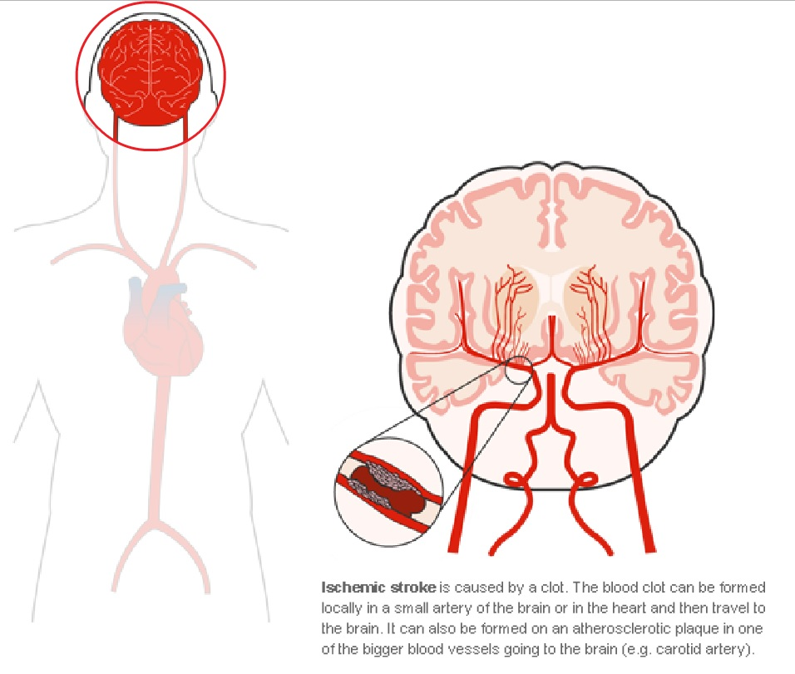
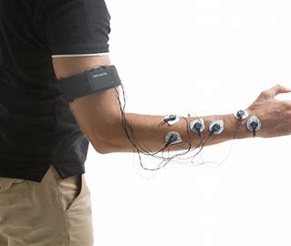
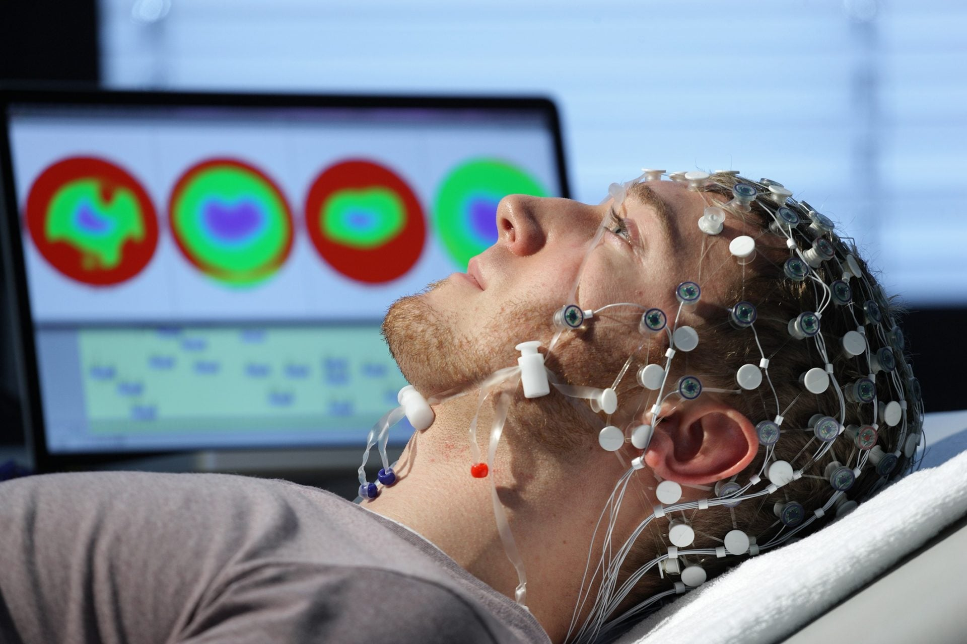
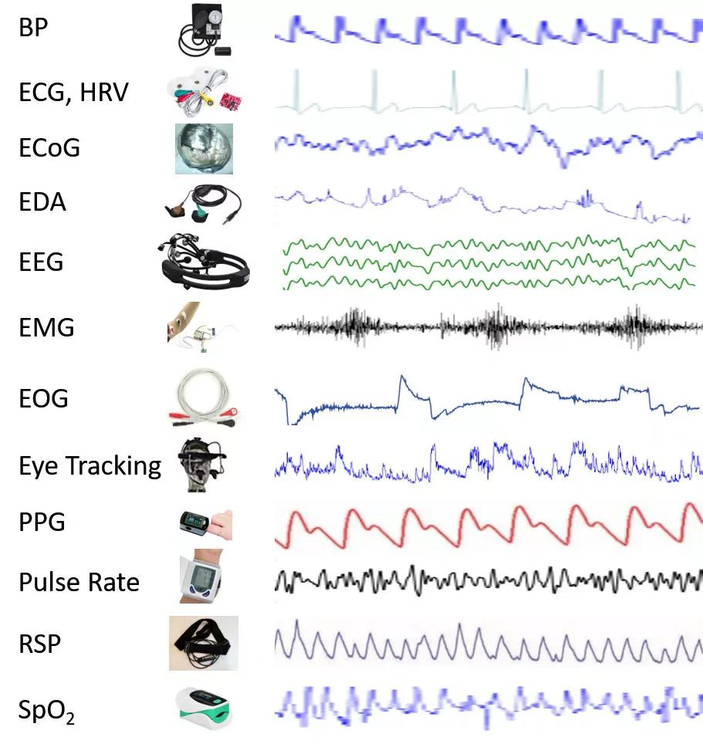
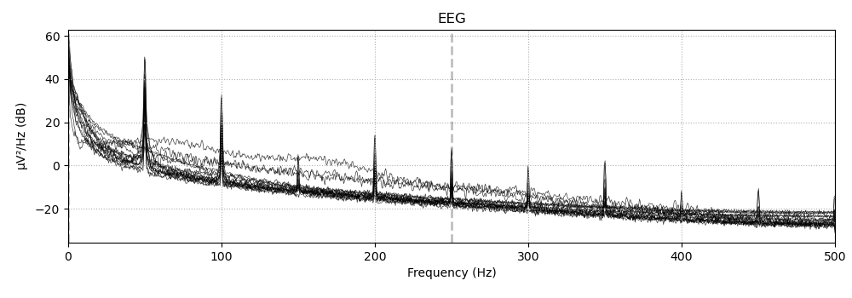
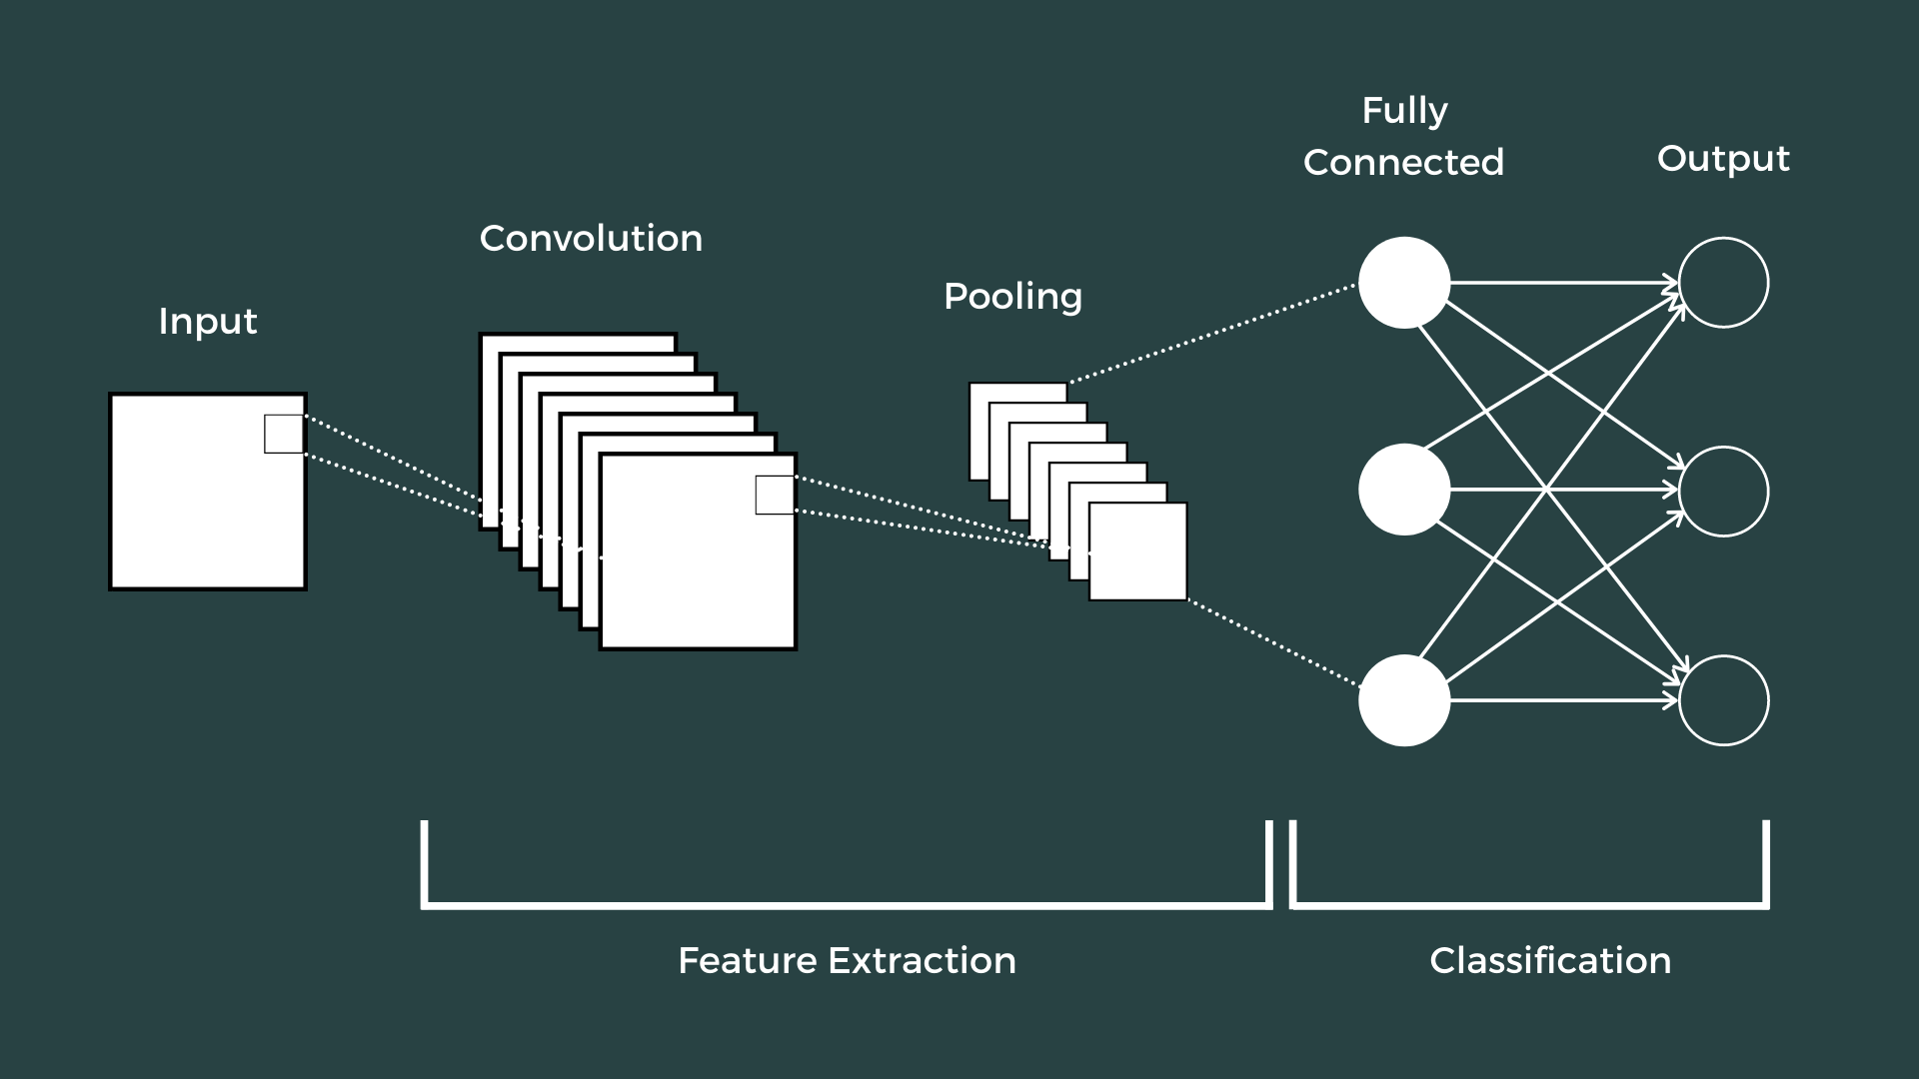
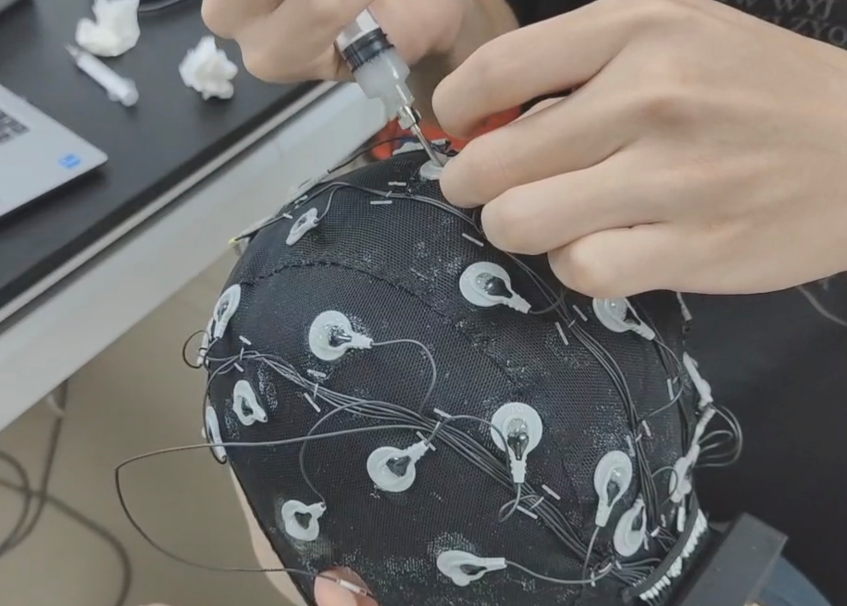
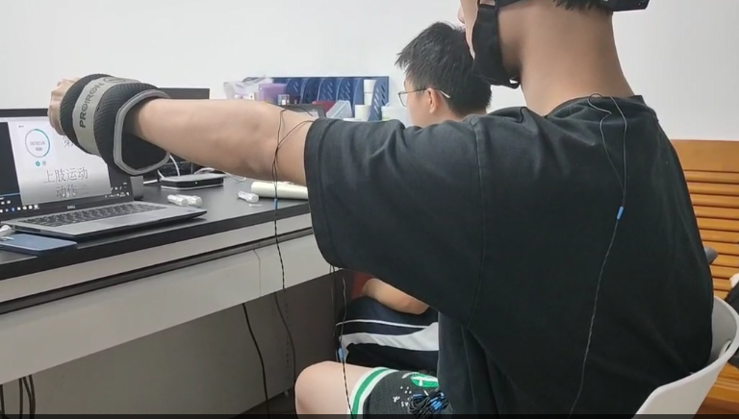
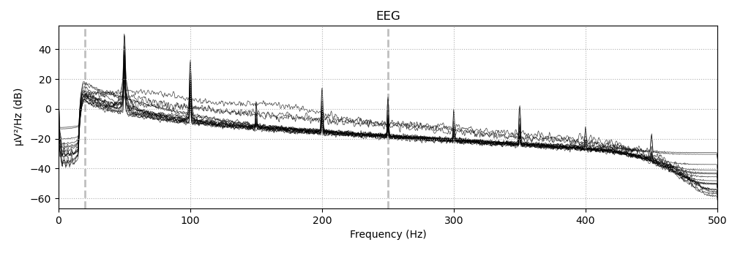
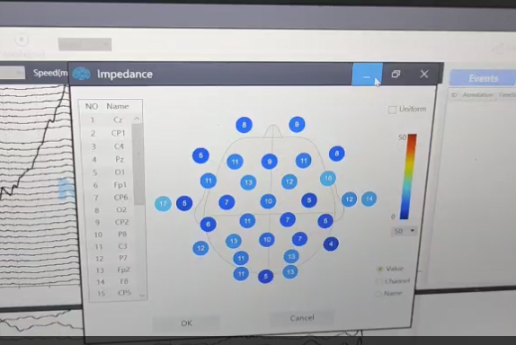
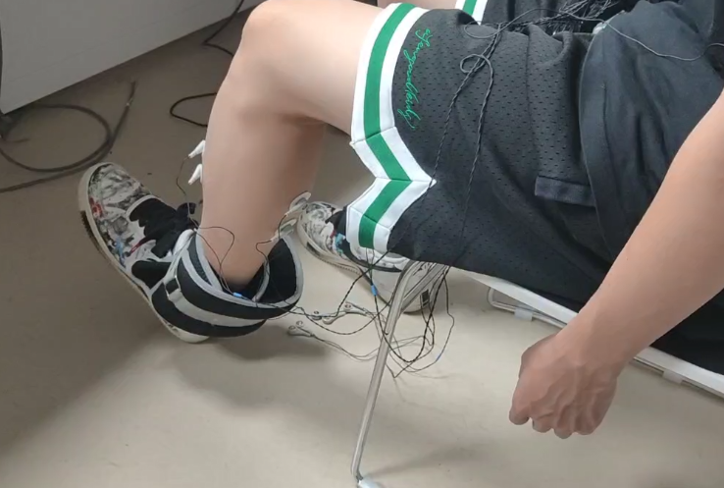
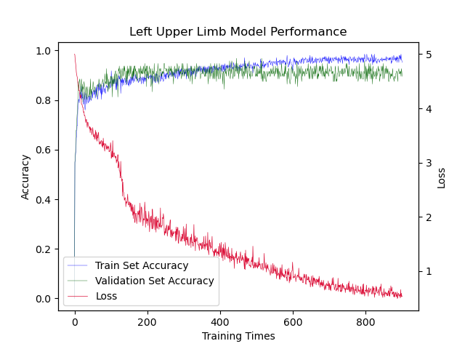
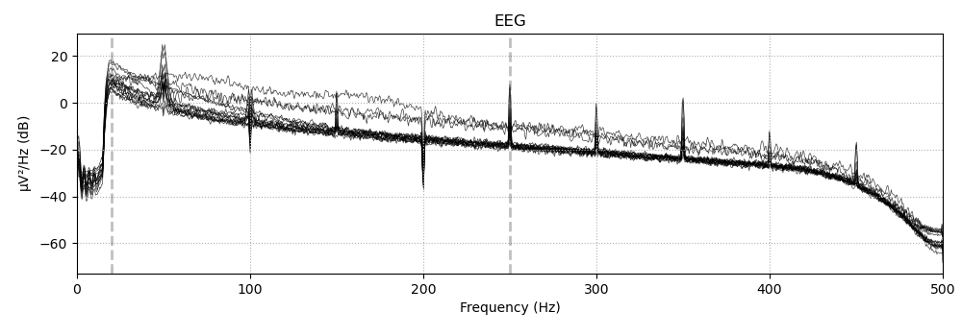
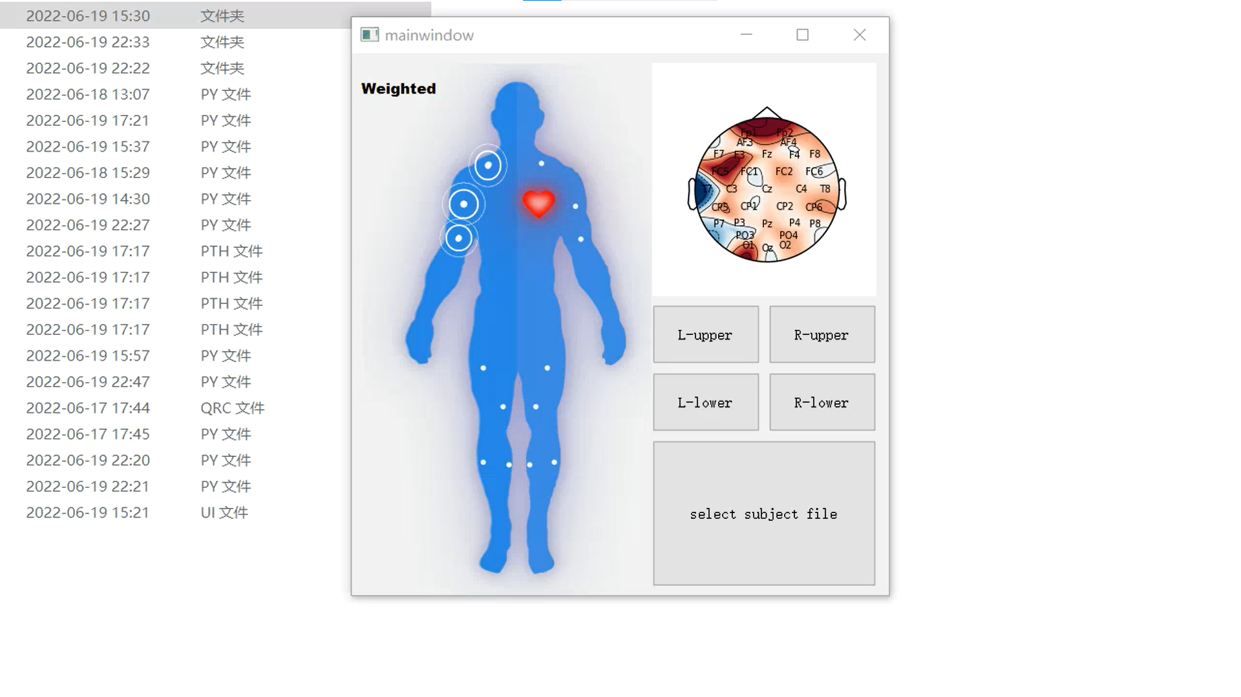

Limbs Motor Function Monitoring System
—Based on EEG and EMG detection and analysis
Jinbiao Chen, Haoquan Zhang, Yubin Zhou, Haiyang Yao, Kaiwen Li,
School of Biomedical Science and Engineering, South China University of Technology
BACKGROUND
Nearly 70 million stroke patients in China
More than 2 million new cases each year
EMG signal
measurement
EEG signal
measurement
other signal
measurement
Stroke is a disabling disease that causes limbs dysfunction
Because of the current highly subjective and inefficient diagnosis in the diagnosis of extremity motor dysfunction. It is urgent to develop a monitoring system with multi-physiological parameters that is objective, accurate, efficient and easy to use.
PROCESS
RAW
BANDPASS
Build a convolutional neural network(CNN for short) model to determine whether the test subject is weighted or weightless. After adjustment, we found that the model with the muscle electrical signal data on the upper left side of the human body as input could achieve 90.62% accuracy.
#401024
TRAPPING
1. Acquisition of EEG and EMG data
2. Data pre-processing
3. CNN model construction
Converting the format of data from nparray two-dimensional matrix to python's list
DISCUSSION
Q: Why is the left upper limb the most correct?
A: Our subjects were basically left-handed, so the upper left part had the least amount of force. Based on these facts, we can make a hypothesis: the less forceful the limbs, the more different the EMG signal is, so that the diognosis is more accurate.
Q: Does the fact that the CNN model ultimately uses upper left EMG data as input suggest that EEG is not important?
A: All of our data are from healthy people, so their EEG signals is not significantly different. However, the brain structure of stroke patients is significantly damaged and their EEG signals are significantly different. EEG signals are still very important for patients with structural changes in the brain.
Q: Why do we need to acquire 32 channels of EEG signals？
A: If there are too few channels, we may lose information. If there are too many channels, the economic cost will be much higher.
Q: What will be the follow-up of this work?
A: First, The design of the experimental paradigm could be more detailed, allowing for more standardized data collection. Second, The accuracy of the model can be improved if the number of data sets can be improved. Third, Combining more parameters to assess the subject's limbic motor function, such as rSO2
Normalization of in-list data
(amplitude adjustment)
Calculating the variance and determining whether the subject's data are in motion (action potential)
Returning a sequence containing time and motion states
Topographic mapping of EEG using matlab plug-in, displayed using canvas control
4. Visualization of EEG and EMG signals
5. Final monitoring system combining the GUI and the back-end
SCHOOL OF BIOMEDICAL SCIENCE AND ENGINEERING
GUANGZHOU INTERNATIONAL CAMPUS
SOUTH CHINA UNIVERSITY OF TECHNOLOGY
Design by Haoquan Zhang

